Slide 1
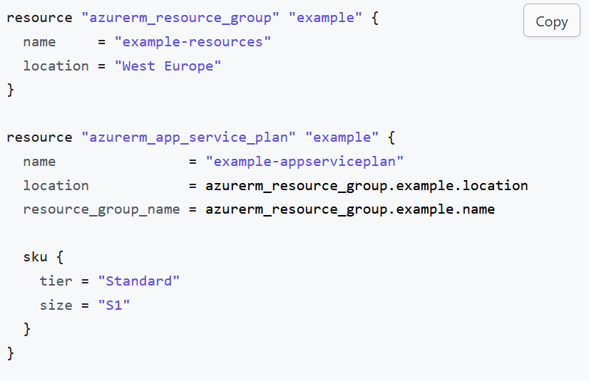
How to read data in terraform

Slide 2
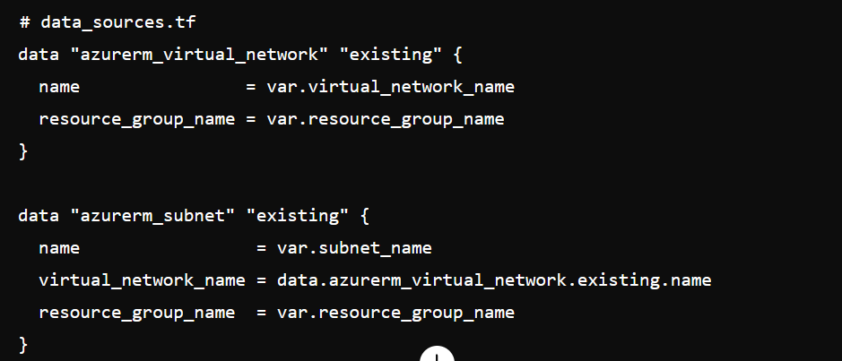
Creating VNET and Subnet

